Slide 1
Loan Prediction Model using Machine Learning
Presented By:
Sachin Ramdas Digraskar
Batch No.THA-SEP2022-DS-1

Slide 2
Index
Problem Statement
Life cycle to build Model with Machine Learning (ML)
Data Acquisition & Features present in Dataset
Data Understanding & Cleaning
Exploratory Data Analysis (EDA)
Data Visualizations (Scatter plot)
Data Visualizations (Heat Map)
Machine Learning Model
Model
Machine Learning Model of training and testing the dataset.
1. Machine Learning models using Logistics Regression ,SVC and Random Forest Classification
2.Machine Learning models with Hyper parameter tuning ( Logistic ,SVC & Random Forest Classification)
Loan Prediction Models comparison & conclusion.

Slide 3

Problem Statement
Problem Statement:
Loan prediction
Let's Say, You are the owner of the Housing Finance Company and you want to build your own model to predict the customers are applying for the home loan and company want to check and validate the customer are eligible for the home loan.
The Problem is, In a Simple Term, Company wants to make automate the Loan Eligibility Process in a real time scenario related to customer's detail provided while applying application for home loan forms

Slide 4
Life Cycle to build Model with ML
Steps are:
Understand the Business Problem
Data Acquisition
Data Cleaning
Exploratory Data Analysis
Deploy the Model
Predict your Model Accuracy
Machine Learning Algorithm

Slide 5
Data Acquisition & Features present in Dataset
Data Acquisition :
We have received data a CSV file (train & test datasets)
Import the Library :
import pandas as pd
import numpy as np
import matplotlib.pyplot as plt
%matplotlib inline
import seaborn as sns
Load the Dataset :
Show the Dataset Path to get dataset
loan_train =pd.read_csv(r 'D:\BIA\SD_Load Prediction/loan-train.csv')
loan_test = pd.read_csv(r‘ D:\BIA\SD_Load Prediction/loan-test.csv')
Index 0 | Index 1
Loan_ID | Unique Loan ID.
Gender | Male/ Female
Married | Applicant married (Y/N)
Dependents | Number of dependents
Eduction | Applicant Education (Graduate/ Under Graduate)
Self_Employed | Self-employed (Y/N)
ApplicantIncome | Applicant income
CoapplicantIncome | Coapplicant income
LoanAmount | Loan amount in thousands
Loan_Amount_Term | Term of a loan in months
Credit_History | Credit history meets guidelines
Property Area | Urban/ Semi-Urban/ Rural
Loan Status | Loan approved (Y/N)

Slide 6
Data Understanding & Cleaning
Understanding the data:
loan_train.head() : used to return top n (5 by default) rows of a data frame or series.
loan_train : loan_train to show few rows from the first five and last five record from the dataset
loan_train.shape : To check the dimension.
loan_train.describe() : information of all the mathematical details from dataset. Like count, mean, standard deviation (std), min, quartiles(25%, 50%, 75%) and max
Data Cleaning:
Dropping irrelevant columns and rows
Identify duplicated columns
Renaming Columns
Checking number of missing values in the dataset.
'

Slide 7
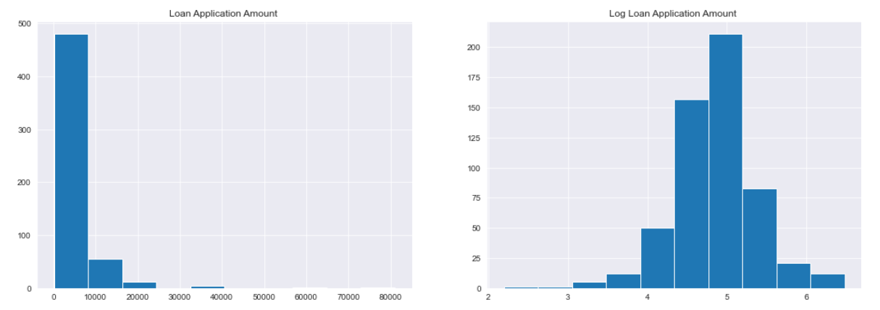
Exploratory Data Analysis (EDA)
Exploratory Data Analysis (EDA):
In this histogram Plot , we can see that Loan Applicant Amount is higher in range of 0 – 10000 USD and lowest range 32000 – 42000 USD

Slide 8
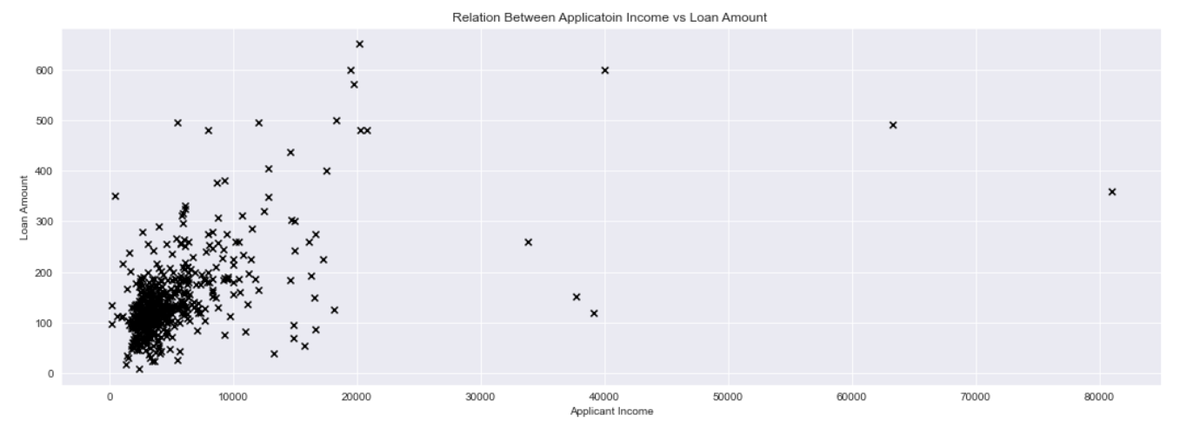
Data Visualizations (Scatter plot)
In this Scatter plot ,We can see that applicant who have income lesser that 10000 take frequent loans of 100 to 200 dollars

Slide 9
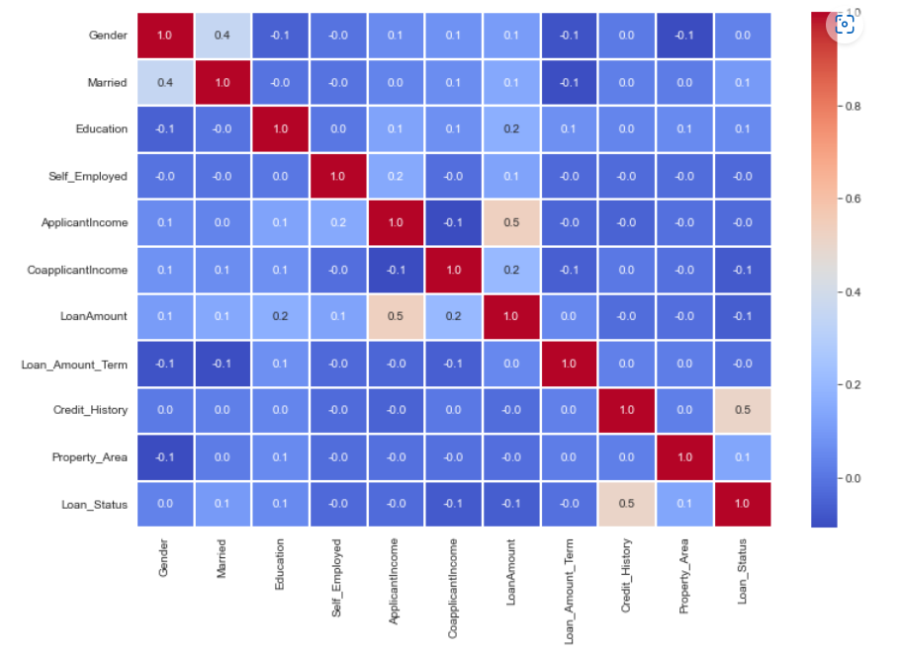
Data Visualizations (Heat Map)
In this heatmap, we can clearly seen that loan status is highly correlated with credit history

Slide 10
Machine Learning Model
logistic regression.
Logistic regression is one of the most popular Machine Learning algorithms, which comes under the Supervised Learning technique. It is used for predicting the categorical dependent variable using a given set of independent variables
Logistic regression is used for solving the classification problems.
Support Vector Classification (SVM)
A support vector machine (SVM) is a type of deep learning algorithm that performs supervised learning for classification or regression of data groups. In AI and machine learning, supervised learning systems provide both input and desired output data, which are labeled for classification.
Random Forest Classification
Random Forest is a popular machine learning algorithm that belongs to the supervised learning technique. It can be used for both Classification and Regression problems in ML.

Slide 11
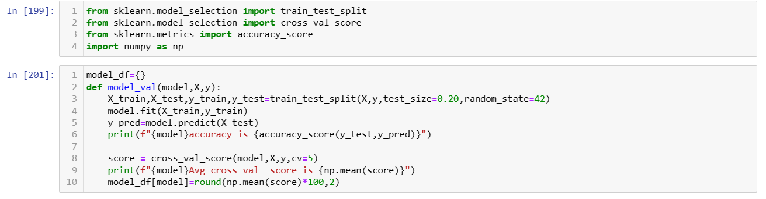
Machine Learning Model
Splitting the data set into the Training Set and test set & applying K -fold cross Validation

Slide 12
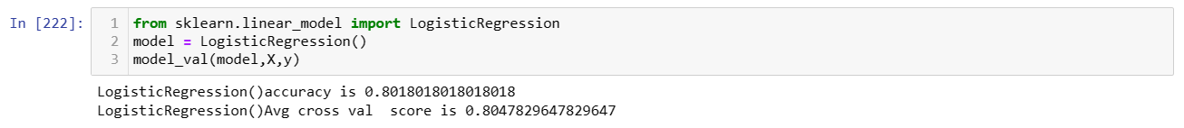
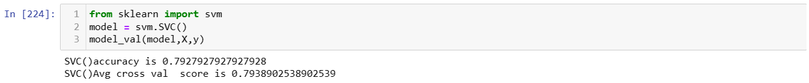
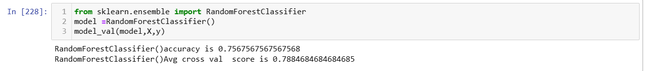
Machine Learning Model
Logistic Regression :
Support Vector Classification (SVC)
:
3. Random Forest Classification

Slide 13
Hyperparameter Tuning
Hyperparameter Tuning
from sklearn.model_selection import RandomizedSearchCV
Logistic Regression :
Support Vector Classification (SVC)
Random Forest Classification

Slide 14
Loan Prediction Models Comparison
Loan Prediction | Accuracy | Accuracy using K -fold cross validation | Hyper parameter tuning
Logistic Regression | 80.18018018018018 | 80.47829647829647 | 80.47829647829647
Support vector classification | 79.27927927927928 | 79.38902538902539 | 80.66011466011467
Random Forest Classification | 76.57657657657657 | 78.66502866502867 | 80.66175266175266
Conclusion : This means that from the above accuracy table , we can conclude that Random Forest Classification is best model for the loan prediction problem.

Slide 15
Thank You

